Slide 1
Applied Learning Activities
Judy Levings, Ph.D.
Department of Agricultural Education
and Studies

Slide 2
Think about the most effective activity you created for a class or experienced as a student.
What made the activity effective?

Slide 3
Purpose of ALA Sessions
Review the ALA template.
Review frameworks, cognitive load theory and scaffolding to ALA design.
Review writing an ALA purpose/objective; write an ALA procedure or task, background and assessment questions.

Slide 4
What is an Applied Learning Activity?
“Is an exercise, case study, learning task, scenario, or an experiential learning activity used by educators to model expertise to learners and by learners to develop competence in applying course content.”
(Mills, Rick).

Slide 5
ALA’s help build competence
Help learners perform real-world plant breeder tasks.
Encourage learners to use the thinking strategies plant breeders use.
Assist students in becoming more conscious about what content and knowledge they need to do the job.
Give students a safe setting to fail
Image licensed under Creative Commons Attribution 2.0 Attributed to Center for Teaching,
Vanderbilt University

Slide 6
So you need to know
What competency, proficiency and expertise looks like in plant breeding
Core Competencies
Continued professional development
Consultation with breeders & researchers
Then educational experiences can be developed.

Slide 7
What makes for an Effective ALA?

Slide 8
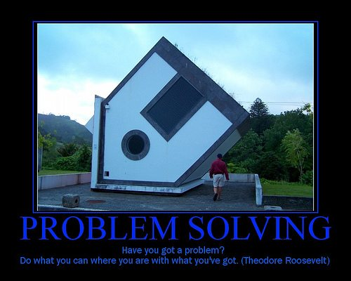
A problem-based approach
where students apply their knowledge by solving open-ended questions/problems.
The problem should:
motivate students to seek deeper understanding of concepts.
require students to make reasoned decisions and to defend them.
incorporate the content objectives in such a way as to connect it to previous courses/knowledge.
Include a level of complexity to ensure that the students must work together to solve it (if a group project)
Consult a variety of sources: newspapers, magazines, journals, books, textbooks, and television/ movies.
This Photo by Unknown Author is licensed under CC BY-SA

Slide 9
Identification or creation of Frameworks
Cognitive strategies, approaches, or models that help ‘frame’ a problem so it can be solved.
What are these in your content area?
They can be fixed to a discipline or instructors can create them to assist in understanding.
The 5-element framework for analyzing a breeding operation:
1. Establish objectives
2. Create variability
3. Evaluate progeny
4. Select progeny
5. Increase progeny

Slide 10
Think about a plant breeding problem in your subject area. .
What frameworks exist to help students solve a problem in plant breeding?

Slide 11
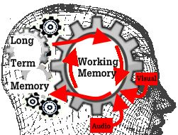
Cognitive Load
Learning happens best when what you are teaching matches the abilities of student’s working memory.
Goal is to develop permanent knowledge, by creating good lessons that:
Minimize distractions to make the learning process more manageable.
Are challenging, but not defeating.
Increase in complexity at a rate manageable by the learner.

Slide 12
Scaffolding
Practices that help students incrementally make progress towards stronger understanding
Instructors provide temporary support to reduce panic or frustration.
1. Simplify versions of an assignment then gradually increase the difficulty over the length of the course.
2. Illustrate the concept, problem or process in multiple ways.
3. Model the thinking process in class.
4. Describe in detail the purpose and directions students need to follow.
5. Explain to students how the activity builds on knowledge and skills students where previously taught.

Slide 13
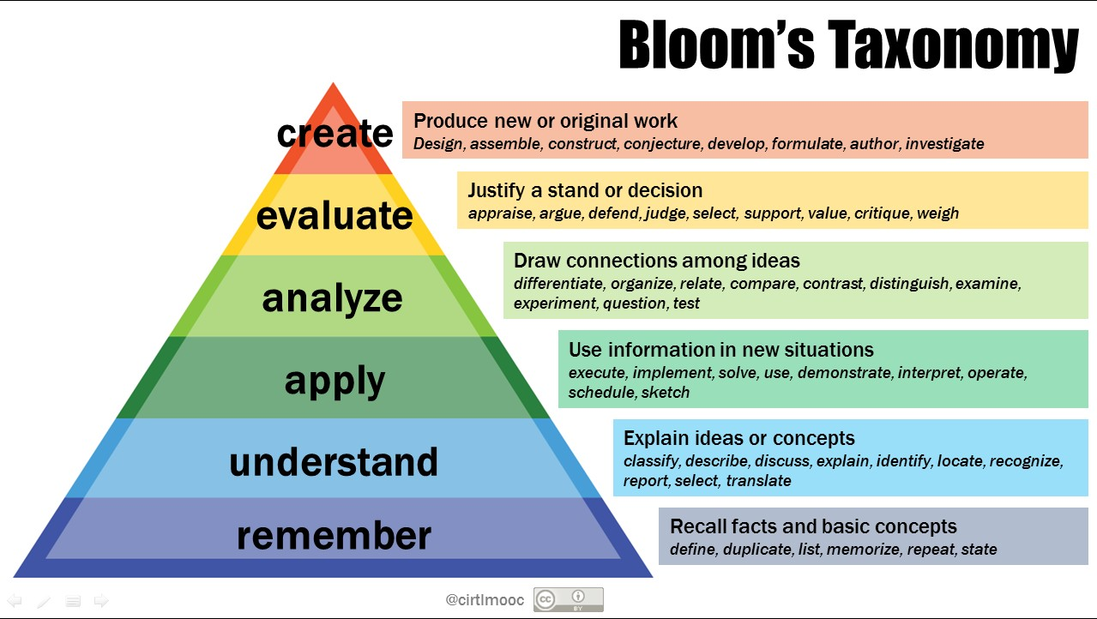
Bloom’s Taxonomy
Think about a course you teach.
What problem should they be able to solve?
Write it would as an objective (ABCE)

Slide 14
Review the ALA Template
Creating an ALA is like creating a Lesson Plan. It is an iterative process.
But- start with your objectives, then assessment, then methods.
Fill in the components and modify as you develop.

Slide 15
ALA Template: The Beginning Stuff
Title: is self-explanatory.
Names of authors: Modifying an existing ALA? List previous authors first and your names at the end. Include the institution for ease in contacting you.
Name of the PBEA Course and Module:
Pre-requisite learning: List concepts/skills in the module students need to understand before attempting to complete the ALA.

Slide 16
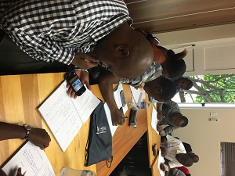
ALA Template: Materials & Time
.
Materials: Data Sets, Software, References, Slides etc.
Listing upfront- helps reduce cognitive overload, confusion
Time: Estimate the amount of time for students to complete.
Time management.

Slide 17
ALA Template: Background
Information to assist in successful completion.
Gets the student’s attention.
Provides real-world connection.
There are many methods to bring life to your applied learning activities.
Use methods help students develop expert thinking processes through engaging in real life type activities

Slide 18
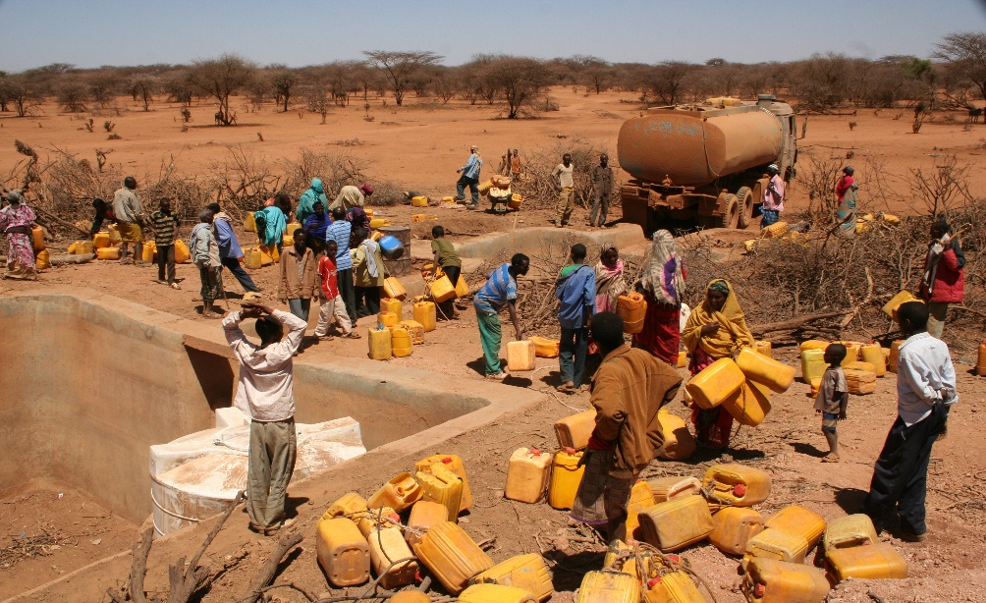
Methods
Case Study
Simulations
Scenarios
Problem-based Method
Image licensed under Creative Commons Attribution 2.0.

Slide 19
ALA Template: Procedure or Tasks
Step by step description of what you want students to do.
When designing think about these educational concepts.
Frameworks
Cognitive Load Theory
Scaffolding
Bloom’s Taxonomy

Slide 20
Questions to Ask Yourself
When working on your ALA ask yourself:
What procedures, concepts, and knowledge will the learner need to know and be able to apply?
What analytical and evaluative skills for this do the students have?
Do students have the resources to perform the tasks?
Have I modelled the thinking process I want the students to use?
Is the ALA written in a way they know what I want them to do and how they will be graded?

Slide 21
ALA Template- Reflection
Reflection Questions:
Content questions: These can be in the body of the procedure/tasks section or you can include them in this section.
Remember Bloom’s
Debrief questions: Ask students to respond to questions about completion of the ALA- How did it go, what challenged you, what surprised you?

Slide 22
ALA Template: Assessment Strategy
How will you assess student understanding?
How will it be graded?
What ways do you suggest?

Slide 23
ALA Template: Answer Keys

Slide 24
Acknowledgements
Rick Mills. Introduction to Applied Learning Activities in Plant Breeding. https://pbea.agron.iastate.edu/course-materials/other-materials/introduction-applied-learning-activities
Judy Levings, PBEA-PLC Coordinator, Agriculture Education and Studies, Iowa State University
Siddique Muhammad-Aboobucker, Agronomy Post-Doctoral Student, Iowa State University

