Slide 1
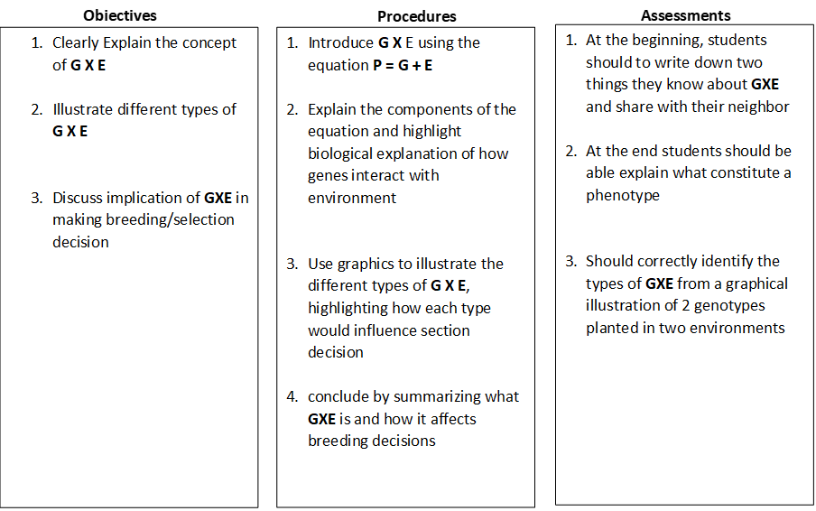
LESSON PLANING TEMPLATE
Lesson tittle: Concept of G X E
Course: Quantitative Genetics Module: G X E Unit: Multi-environment trials
Core Competency: Concept and types of G X E Author: Patrick Ongom Time: 12 mins

Slide 2
Topic: G X E
Objectives
Clearly Explain the concept of G X E
Illustrate different types of G X E
Discuss implication of GXE in making breeding/selection decision
Outlines
Concept of GXE
Biological explanation of G x E
Types of GXE
Summary
Concept check quiz

Slide 3
You may have heard that your genes govern who you become. You may have even blamed or thanked your genes for a few things. Your height, your personality, your dimples - these are all a reflection of your genetic makeup
Is this totally true?

Slide 4
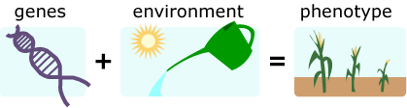
Concept of G x E
G (genetic make up)
E (temperature, precipitation etc)
P (yield, disease reaction etc.)

Slide 5
Biological insight of G x E
Proteins and function

Slide 6
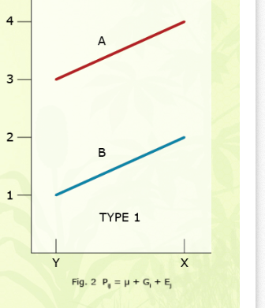
Types of G x E and implications
Type 1:
Consistent genotype performance across the two environments
No interaction
Genotype A is clearly the best one
Yield (t/ha)
2 units
2 units
Environment

Slide 7
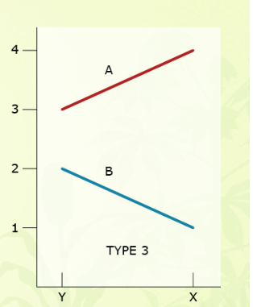
Types of G x E and implications
Type 2:
Change in magnitude of genotype performance
Presence of interaction (non-crossover interaction)
Genotype A is still clearly the best one, B is worse in environment X
Yield (t/ha)
2 units
1 unit
Environment

Slide 8
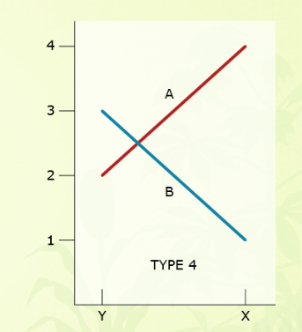
Types of G x E and implications
Type 3:
Change in rank of genotypes across environments
Presence of Cross over interaction
May Select for specific environment
Yield (t/ha)
Environment

Slide 9
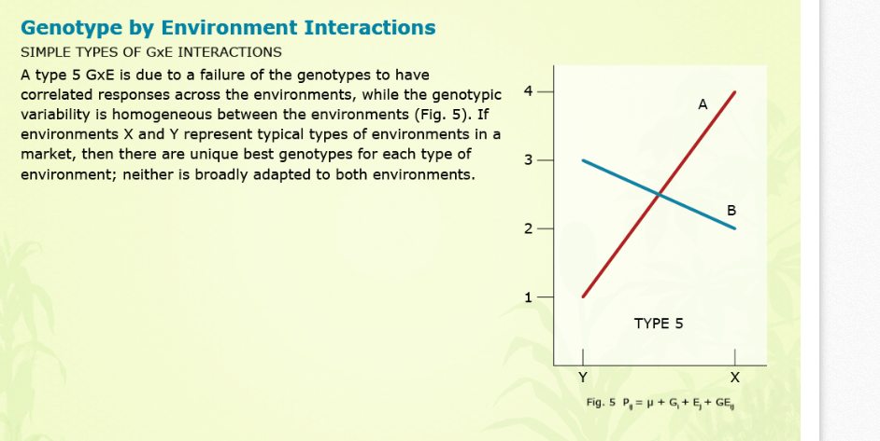
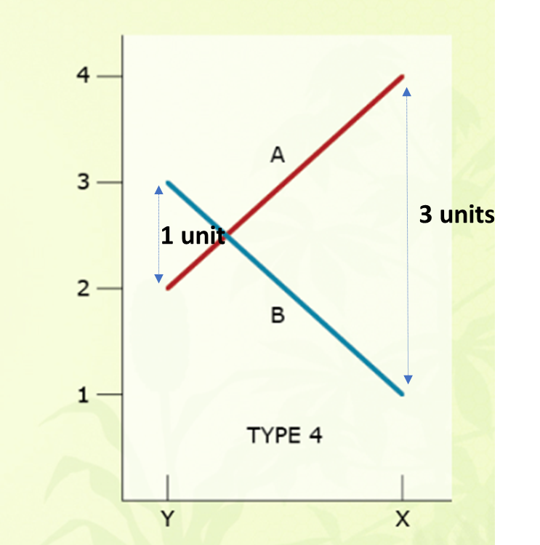
Variants of cross over G x E interaction
2 units
2 units

Slide 10
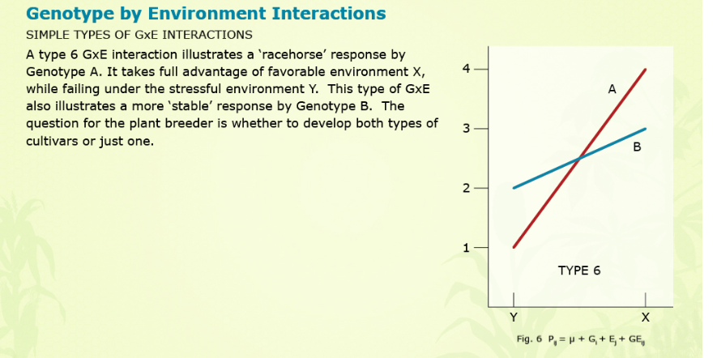
Variants of cross over G x E interaction
1 unit
3 units

Slide 11
Summary
Phenotype is a mixture of gene effect and environment effect
  Modeled by expression P = G + E
G x E is expressed in different ways:
  non- crossover interaction –change in magnitude
  Cross over interaction (change in ranks)
  variants of crossover (combine change in ranks and magnitude)
Each type affect section decision differently

Slide 12
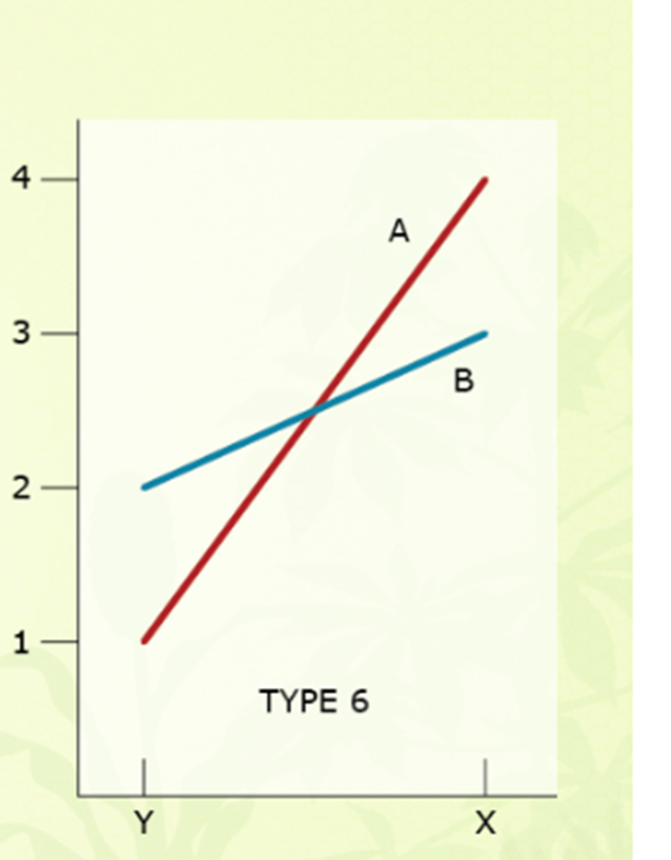
Concept check quiz
Given the graph shown, which of the two genotypes A and B would be preferable?
Why?
White your response and submit before exiting the class

